Slide 1
Terraform Getting Started Guide
For Cloudreach

Slide 2
Agenda
What is Terraform
What is Infrastructure as Code and why use it?
Terraform Lifecycle
Terraform State File
File Structure
Pros and Cons of Terraform
Best Practices and Tools
Demonstration

Slide 3



What is Terraform?
Other Hashicorp products you may know
Open source Infrastructure as Code tool
First released in 2014 by Hashicorp
Supports a wide range of Cloud Providers:
AWS
Azure
GCP
Alibaba Cloud
Etc.
‘Cloud Agnostic’ IaC tool
Terraform version 1.0.0 was released June 2021

Slide 4




What is Infrastructure as Code?
AWS CloudFormation
IaC is a way of creating, altering, and managing resources
Ideal for use in environments where there is a lot of infrastructure to maintain
Manage and maintain all your Cloud resources in one place
Azure Resource Manager
GCP Deployment Manager
Terraform

Slide 5
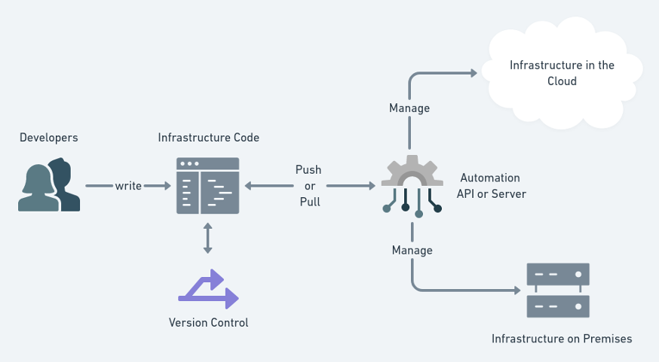
Why use Infrastructure as Code?
Gives good visibility into the infrastructure as a whole
Storing the codebase using Git allows keeping track of changes & code history
Version Control
Easy to rollback breaking changes
Quick and easy to recreate resources in event of an accidental deletion
Perfect for environment staging and testing

Slide 6
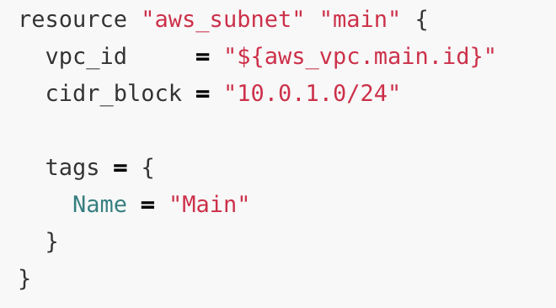
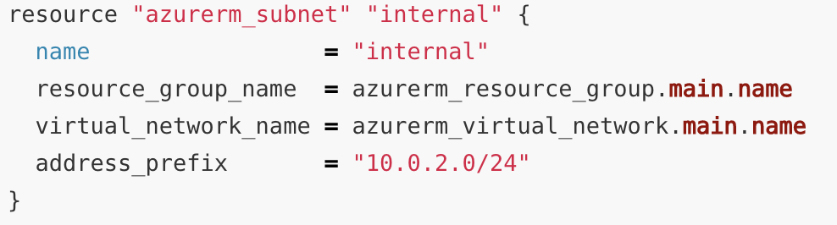
Pros & Cons
Of Terraform
Has functions that can be used to dynamically create resources
Lots of online support and documentation
Cloud Agnostic
Version control
Terraform modules enable reusable code
Ability to “Plan” and “Apply” config
Import pre-existing resources
Doesn’t rollback in event of resource creation failure
Language is ‘Cloud Agnostic’ but implementation is cloud specific

Slide 7

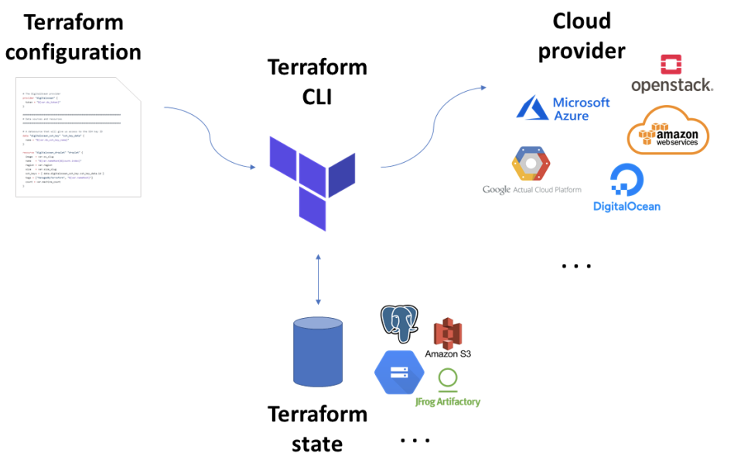
Terraform Lifecycle
terraform init
Initialises terraform by loading the modules & loading remote state
terraform plan
Outputs a list of resources that will be changed
terraform apply
Deploys the infrastructure and writes the changes into the state file
terraform destroy
Deletes all of the infrastructure & removes it from the state file

Slide 8
Terraform State File
Maps infrastructure resources to the terraform code
Use principle of least privilege & encryption - state contains secrets in plain text
Stored locally by default
State should be stored in:
AWS S3
Azure Blob Storage
GCP Container Storage
Can be used to import pre-existing resources

Slide 9
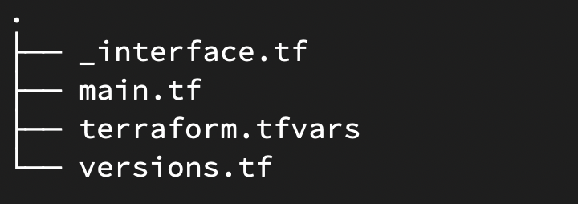
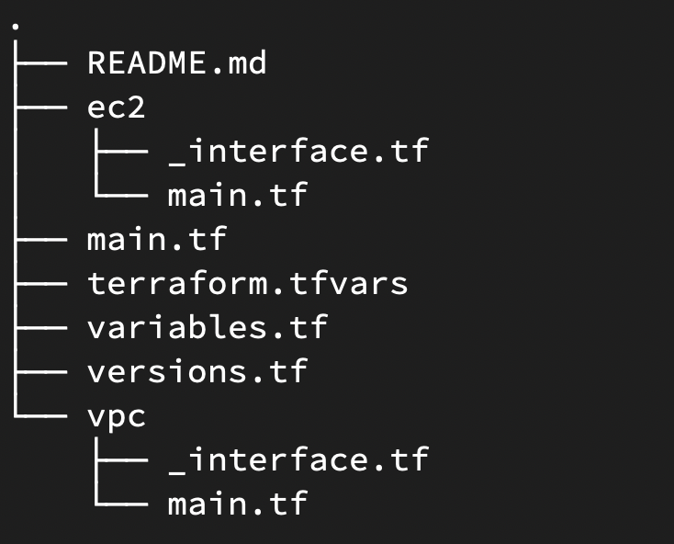
File structure
Modules gives you the ability to reuse code
Flat directory
Modules make it easier to find resource configuration at a glance
main.tf
The main file which holds the resource configuration.
_interface.tf
Declares variables & outputs and any extra information that could be useful. e.g. description, variable type
terraform.tfvars
Holds the variables themselves
versions.tf
Where the provider versions can be specified, e.g. aws provider, terraform version
Modules break down the terraform code into smaller sections
Modular directory
Terraform Registry provides a range of modules which are community contributed

Slide 10
Best Practise Tools
terraform fmt - formats terraform code according to official best practise, e.g. correcting indenting, spacing, etc.
terraform-docs - open source plugin for generating READMEs
TFLint - an open source tool for more in-depth validation and linting
TFenv - Sets up a local terraform version for the specific directory folder
terraform-compliance - Behaviour Driven Development to ensure custom security policies are enforced

Slide 11

Demonstration
Notes:
Demo code - https://github.com/cloudreach-coreops/cr_terraform
Show terraformlab first - demo basic tf lifecycle
Then show modules - talk through how modules interact, advantages of using them

Slide 12
Thank you

